Slide 1
scrML Tool Implementation on a C# Environment
by Eduardo Jaime

Slide 2
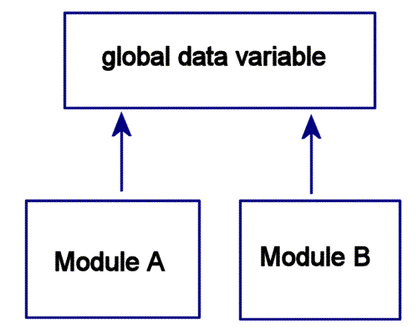
Next Steps
Develop a tool using srcML.NET that:
Converts the selected code base to srcML format.
Queries the selected srcML File.
Detects Common Coupling.

Slide 3
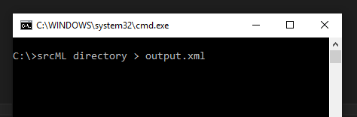

Approach Update
Combined command line tool to convert the code base to XML and a custom made tool made in C# to query the file using XPathDocument.
Easy set up.
XPathDocument offers a straightforward implementation.

Slide 4
srcMLFile vs XPathDocument
srcML.Net offers a class named srcMLFile but the native C# XPathDocument class was chosen instead.
srcMLFile can load a document in srcML Format and offers some functions to query the document using LinQ. It can also be used to modify the codebase.
XPathDocument is a C# class that loads a document in XML format and returns node when queried against an XPath Expression.
This approach was chosen because its simple implementation.

Slide 5
XML File Structure
<unit xmlns="http://www.srcML.org/srcML/src" revision="0.9.5">
<unit language=”c#” filename=”SoruceFile1.cs”>
(Comments, variables and methods)
</unit>
<unit language=”c#” filename=”SoruceFile2.cs”>
(Comments, variables and methods)
</unit>
</unit>

Slide 6
UNIT Structure
<unit xmlns:cpp="http://www.srcML.org/srcML/cpp" revision="0.9.5"
language="C#"
filename="ConstructorHandling.cs"
hash="336e2f0959f373b22eab5cdef109f7a2d72c196a">
<decl_stmt>(Declaration statement)</decl_stmt>
<function>(Method definition)</function>
</unit>

Slide 7
Variable Declaration Structure
XML node that represents the line: int myInt;
<decl_stmt>
<decl>
<type> <name>int</name> </type>
<name>myInt</name>
</decl>;
</decl_stmt>

Slide 8
Method Structure
XML node that represents the line: static void doWork() { more code... }
<function>
<specifier>static</specifier>
<type> <name>void</name> </type>
<name>doWork</name>
<parameter_list>()</parameter_list>
<block> { (Comments, variables declarations and method calls) } </block>
</function>

Slide 9
XPath Expressions for Method Granularity
Objective | XPath Expression
Get all the files in the code base. | //src:unit/src:unit
Get filename for each unit. | //src:unit/@filename
Get all the fields. | //src:class/src:block/src:decl_stmt/src:decl/src:name
Get all the methods that use those fields. | //src:function[descendant::src:name='FIELDNAME']/src:name

Slide 10
Results
The tool CouplingDetector was developed to offer the following functionality:
Convert a code folder into a srcML Format file by implementing srcML.Net from ABB.
Analyse a srcML File to detect common coupling between the methods of a class.
Query a selected document against an XPath Expression and shows the results.

Slide 11
Analysis Algorithm
Select all the Unit Nodes.
Iterate through the results.
For each Unit select all the declared Fields.
Iterate through the results.
For each Field, select the methods that use them.

Slide 12
Conclusion

Slide 13
Thank you!

